Slide 1


SAP UI5 & FIORI with OData TRAINING using BAS
Anubhav Oberoy
Day – 8

Slide 2

Agenda – Day 8
Fragments
Different Ways of loading fragment
Value Help Popup
Use Case 2 – Dynamic Fragment
What is OData?
oData Basics.
Structure of Odata.
Client Side Query With Odata.
Get Operations.
SAP Deployment Options
TCodes and Services
Data Model for our use case
Creating OData Service.

Slide 3
Fragments
Fragments are light-weight UI parts. They are used to modularize views. We can reuse a fragment multiple times in same view or other views.
Fragments are used similar as sap.ui.core.mvc.Views, but Fragments do not have their own controllers. Logic related to fragment’s UI elements is written in the host view’s controller.
Fragments are like parasite, they rely on the controllers of the host views.
There are 2 techniques to create and work with fragments
Direct embedding using fragment
Use JS class sap/ui/core/Fragment and use load function to load it
View1
Controller1
Address – street, house, city, country
fragment
B
Event for fragment button
fragment
B
View 2
Controller2
fragment
Event for fragment button
B

Slide 4
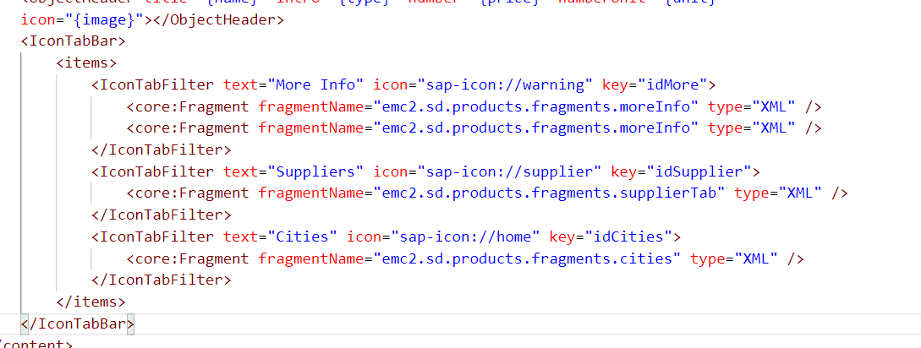
Hands – on: Embedding Fragment in View
For this hands – on we have to create a folder named fragments in the webapp folder and in that folder create fragment files with the extension .fragment.xml.
We will move the Icon Tab bar code to the fragments and will embed them in the View2 to modularize the code of View2.
Create three file in the fragments folder for more Info Section, Supplier Table section and Cities Section.
To including the fragment directly into the XML View use the sap.ui.core.Fragment class as shown below
Ex: <core:Fragment fragmentName=“namespace.fragments.fragmentName" type="XML" />
Code Links:-
View2.view.xml
moreInfo.fragment.xml
cities.fragment.xml
supplierTab.fragment.xml

Slide 5
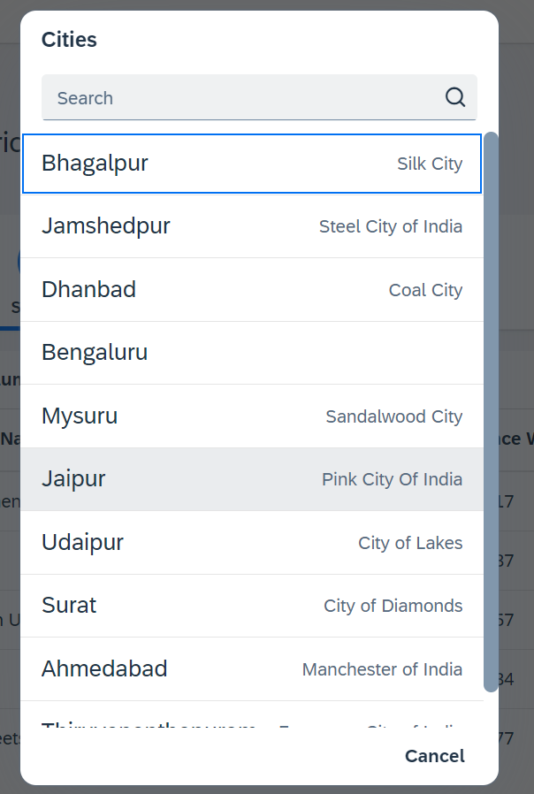
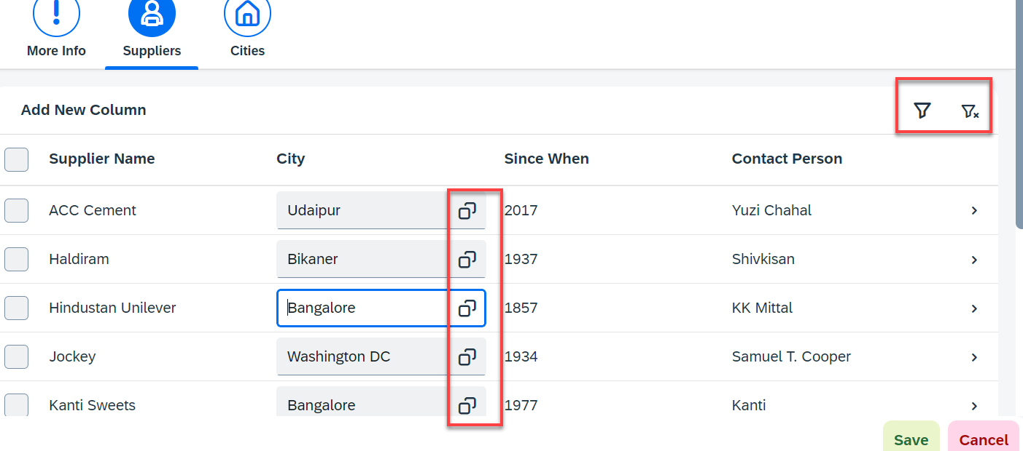
Hands – on: Fragment Use Case 2 (Using JS Code)
My manager asked me to develop following requirements
Add a filter button in the toolbar of the table, and when we click filter icon, it should load a popup with all the list of suppliers. When we select supplier inside filter it should filter data in the table.
Inside the table we have a city field. We would like to enable a value help (F4 Help), when we click on same, it should open a popup which shows all the list of cities on screen.
Part 1: Opening filter popup using the Filter Button.
popup.fragment.xml
supplierTab.fragment.xml
View2.controller.js
Part 2: Opening the Value help popup in the Supplier Table
popup.fragment.xml
supplierTab.fragment.xml
View2.controller.js

Slide 6
Hands – on: Fragment Use Case 2 (Using JS Code)
My manager asked me to develop following requirements
Add a filter button in the toolbar of the table, and when we click filter icon, it should load a popup with all the list of suppliers. When we select supplier inside filter it should filter data in the table.
Inside the table we have a city field. We would like to enable a value help (F4 Help), when we click on same, it should open a popup which shows all the list of cities on screen.
Part 1: Opening filter popup using the Filter Button.
popup.fragment.xml
supplierTab.fragment.xml
View2.controller.js
Part 2: Opening the Value help popup in the Supplier Table
popup.fragment.xml
supplierTab.fragment.xml
View2.controller.js

Slide 7
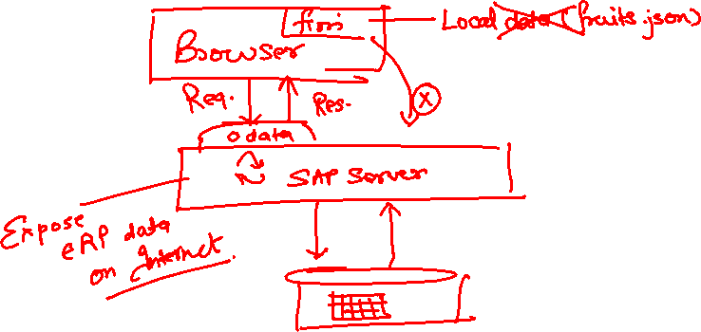
What is OData?
OData Stands for Open Data Protocol, It is an stateless protocol; it is an OASIS standard to communicate to server using REST(Represerntational state Transfer) based service. It was acquired by Microsoft in 2012 and adopted by many companies to build REST services to expose data over internet HTTP/HTTPs protocol.
Funda Fox
Fiori cannot talk to FM, program, CDS views, …. Fiori only and only talk to OData service which is built on top of FM, ABAP code, CDS view.

Slide 8
OData Basics
This OData Protocol is mainly used to expose data over HTTP. It does not matter from consumer point, which technology the OData is built on. This way we are abstracted from the underlaying programming/database. Fiori only and only understand OData, it cannot talk to BAPI, BADI, FM, CDS View, Interface, Class.
Lets start understanding a sample odata given by Microsoft on odata.org
1. Service document – is a collection of entity sets to access the data.
An Entity set is built by an Entity Type. Entity Set is the right end point to perform CURDQ operations
Entity Type describes the structure of the data – metadata
https://services.odata.org/V3/Northwind/Northwind.svc/
2. Service metadata document – describes all the properties and entity types
Which includes key, properties, attributes (nullable, key, max length, create), NavigationProperty
Also includes the relations between entities called association (compare with Foreign key)
Usually one database table is considered as one entity.
https://services.odata.org/V3/Northwind/Northwind.svc/$metadata
https://chrome.google.com/webstore/detail/jsonview/chklaanhfefbnpoihckbnefhakgolnmc
https://chrome.google.com/webstore/detail/xml-tree/gbammbheopgpmaagmckhpjbfgdfkpadb

Slide 9

Structure of an OData URL
http://stcfin.st.com:8021/sap/opu/odata/IWBEP/GWSAMPLE_BASIC/ProductSet?$format=json
http(s)://hostname:port/sap/opu/odata/sap/SERVICENAME_SRV/ENTITYSET?p1=val&p2=val
Protocol
Address & Port
Path prefix
Service Name
End Point Access Data
Query Options

Slide 10

















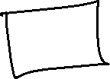










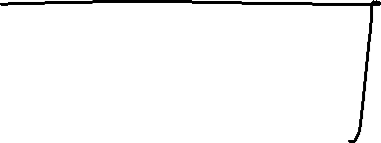

Slide 11
Client Side Query with OData
Sets the page size of results.
02
$top
Indexes into a result set. Also used by some APIs to implement paging and can be used together with $top to manually page results.
Returns the results in the specified media format.
01
03
$format
$skip
ODATA Query
06
04
Retrieves related resources.
Filters properties (columns).
$expand
$select
05
$filter
Filters results (rows).

Slide 12
GET operations
Read All the data from Products (SELECT * FROM dbtab)
https://services.odata.org/V3/Northwind/Northwind.svc/Products?$format=json
Read few properties of entity (SELECT col1, col2 FROM dbtab)
https://services.odata.org/V3/Northwind/Northwind.svc/Products?$format=json&$select=ProductID,SupplierID
Read Top Records (Pagination SELECT * UP TO ROWS n ..)
https://services.odata.org/V3/Northwind/Northwind.svc/Products?$format=json&$top=3&$skip=10
Read data by filtering (SELECT * FROM dbtab WHERE condition)
https://services.odata.org/V3/Northwind/Northwind.svc/Products?$format=json&$filter=SupplierID%20eq%203
SELECT * FROM dbtab WHERE col LIKE ‘%pattern%’
https://services.odata.org/V3/Northwind/Northwind.svc/Products?$format=json&$filter=substringof(%27Cola%27,ProductName)%20eq%20true
Reading count of the records (SELECT COUNT(*) FROM dbtab)
https://services.odata.org/V3/Northwind/Northwind.svc/Products/$count
Reading Single record by its key (SELECT SINGLE * FROM edbtab WHERE pkey = ‘key’)
https://services.odata.org/V3/Northwind/Northwind.svc/Products(11)?$format=json
Join and read data together (SELECT * FROM tab1 INNER JOIN tab2 ON cond)
https://services.odata.org/V3/Northwind/Northwind.svc/Products(11)?$format=json&$expand=Supplier,Category
Association : It’s the relation between multiple Data , it is similar as foreign key relation in DB world
When we create association system will create the navigation property which we can use as a pointer to load the dependent data.

Slide 13
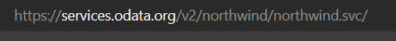
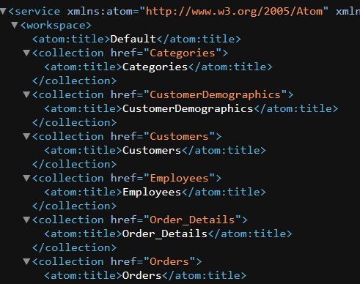
Hands-on : Get Operations
Practice all the get operations in the previous slide by your own on the northwind service url.
Links were given in the previous slide.

Slide 14
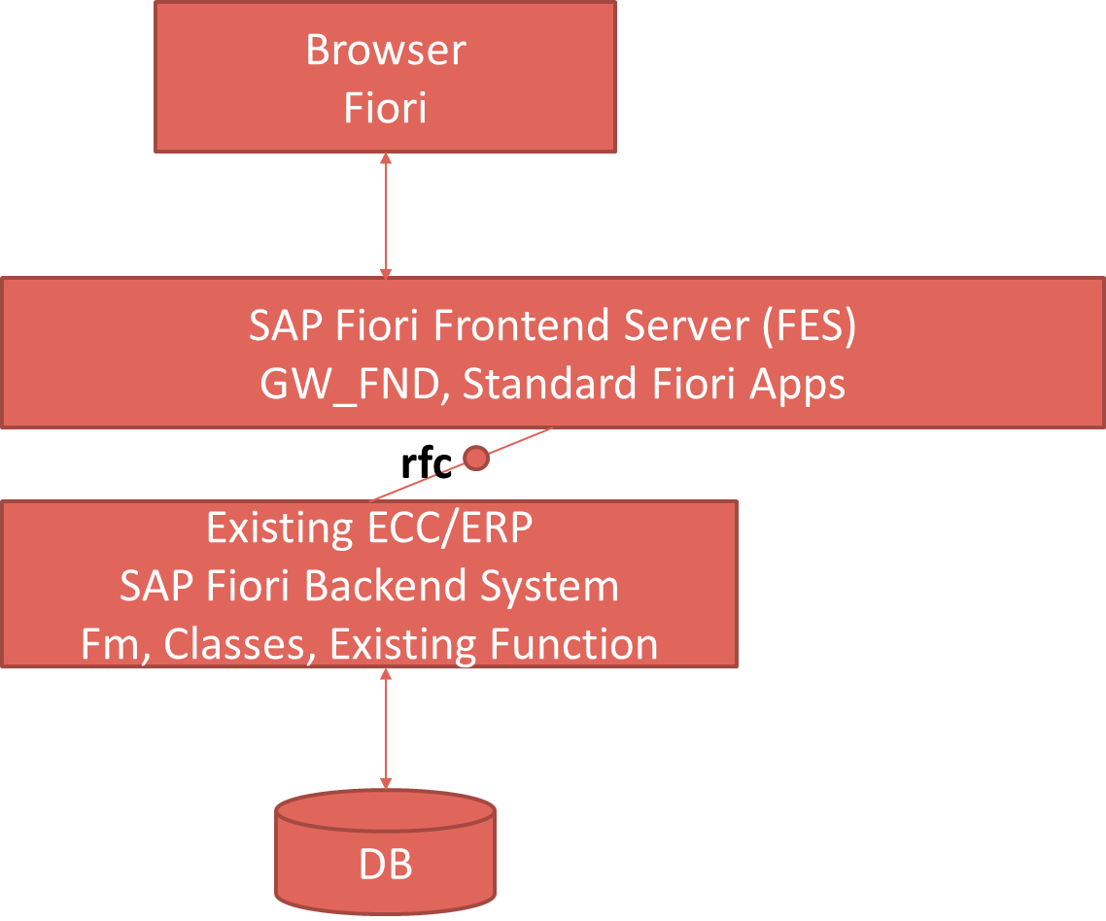

SAP Deployment Options
Central HUB Scenario
Embedded system
Browser
Fiori
SAP Fiori Frontend Server, GW_FND, Standard Fiori Apps
Existing ECC/ERP
SAP Fiori backend System
FM , Classes, existing Function
DB

Slide 15
Pros and Cons
Central HUB Deployment
Cons:
Manage multiple systems
Cost is high
Confusion
User needs to be duplicated
OData Metadata is duplicate
Pros
No need to upgrade
Separation of concerns
Works like a HUB
Recommendation
https://www.sap.com/documents/2018/02/f0148939-f27c-0010-82c7-eda71af511fa.html
Embedded Deployment (recommended)
Pros –
Less Costly
No confusion
No redundancy
Cons –
- Upgrade
- All load on one system

Slide 16
TCodes and Service
SEGW – SAP Service Gateway Builder
/n/IWFND/MAINT_SERVICE – Register the service
/n/IWFND/GW_CLIENT – gateway client – test locally
/n/IWFND/ERROR_LOG – Check errors, troubleshoot
EPM – Enterprise procurement model – Demo data model given by SAP for Training and demonstration.
ITeIO
SO
Customers
PO
Suppliers
Invoices
Stock

Slide 17

Data Model for our use case
EPM Data model = Enterprise Procurement Model
This is a sample data model for learning and education purpose since it is a demo model, we are not risking any productive objects in our system. The data model has Function Modules called as BAPI(Remote enabled FM).
All the BAPI starts with BAPI_EPM*
Products (SNWD_PD, SNWD_TEXTS)
BAPI_EPM_PRODUCT_GET_LIST – All the list of products
BAPI_EPM_PRODUCT_GET_DETAILS – Read single product by key
BAPI_EPM_PRODUCT_CREATE – Create new product
BAPI_EPM_PRODUCT_DELETE – Delete product
BAPI_EPM_PRODUCT_UPDATE – Change data of a product
Business Partners (SNWD_BPA)
BAPI_EPM_BP_GET_LIST – All the list of Business Partners
BAPI_EPM_ BP_GET_DETAILS – Read single Business Partners by key
BAPI_EPM_ BP_CREATE – Create new Business Partners
BAPI_EPM_ BP_DELETE – Delete Business Partners
BAPI_EPM_ BP_UPDATE – Change data of a Business Partners
Orders (SNWD_SO, SNWD_SO_I)

Slide 18
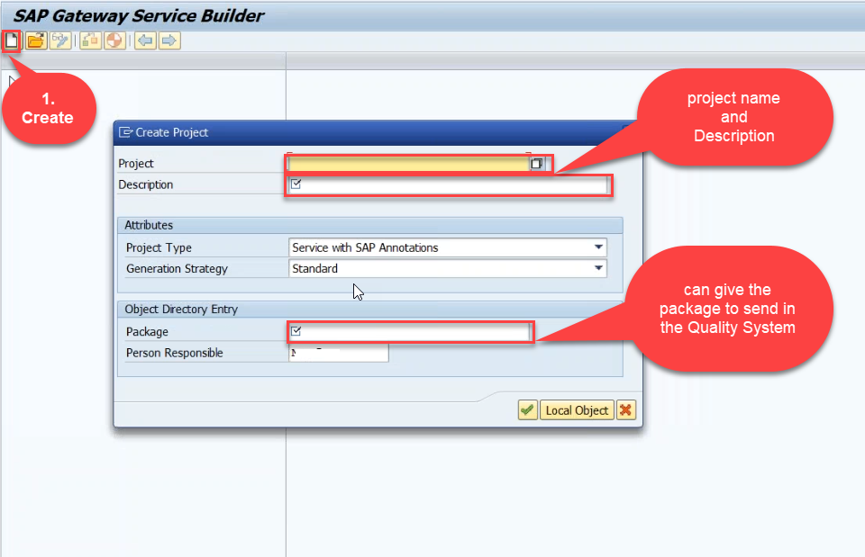
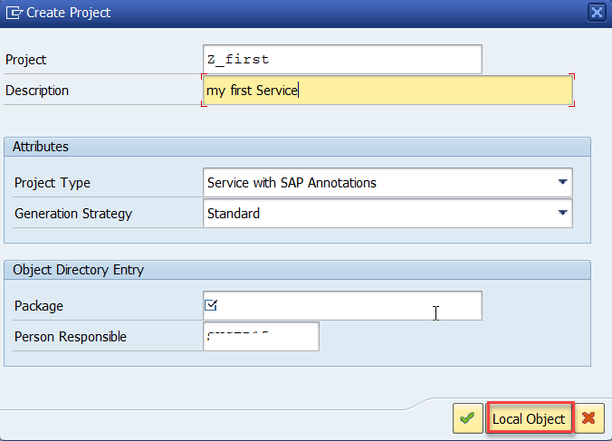
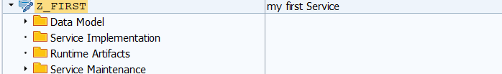
Creating OData Service Project
Step1: Start your SAP LOGON, and to Sap Gateway Service Builder(SEGW) and click on Create

Slide 19
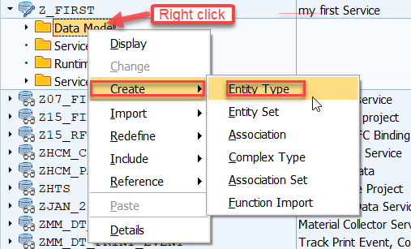
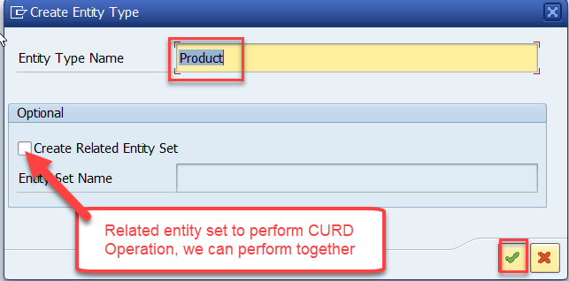
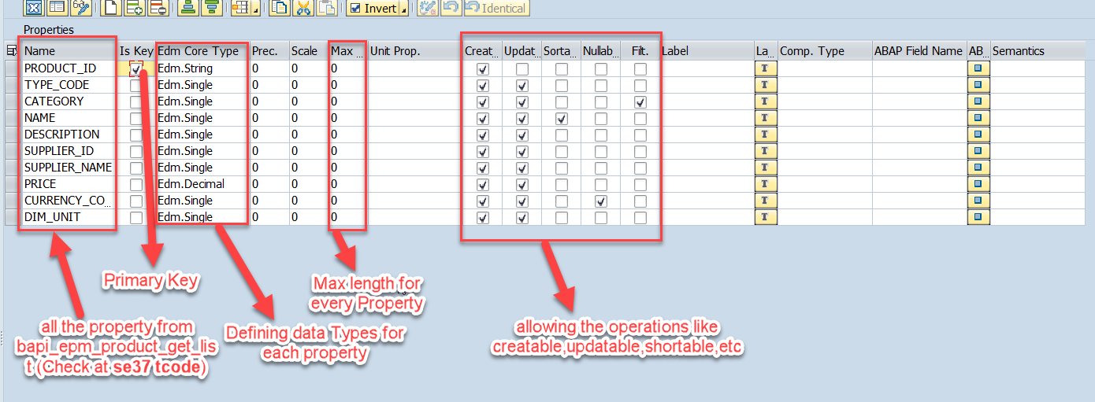
Creating OData Service Continue…
Step2: Defining the Data Model (Blueprint of data)
Step3: Creating Properties for data model (from bapi_epm_product_get_list (TCode- se37))

Slide 20
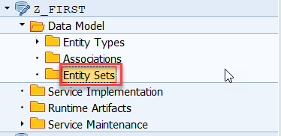
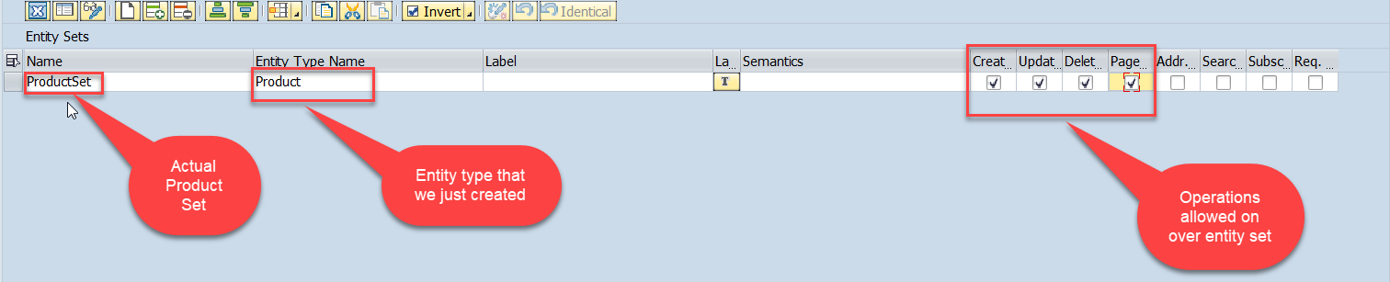
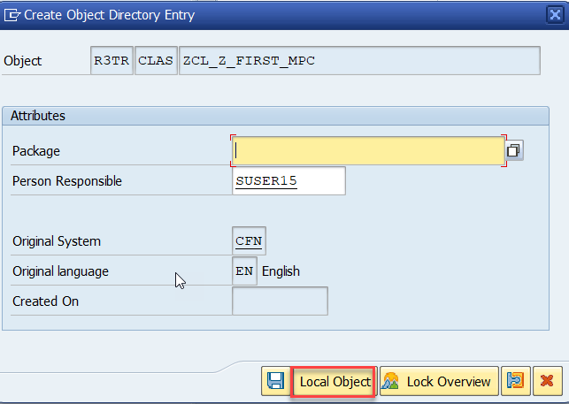
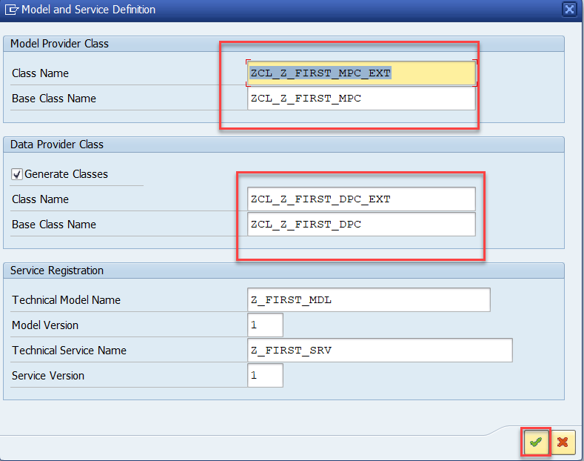
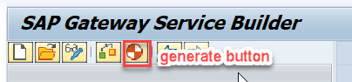
Creating OData Service Continue…
Step4: Creating entity set to perform actual CURD operations and service generation.
This is the name of your service

Slide 21
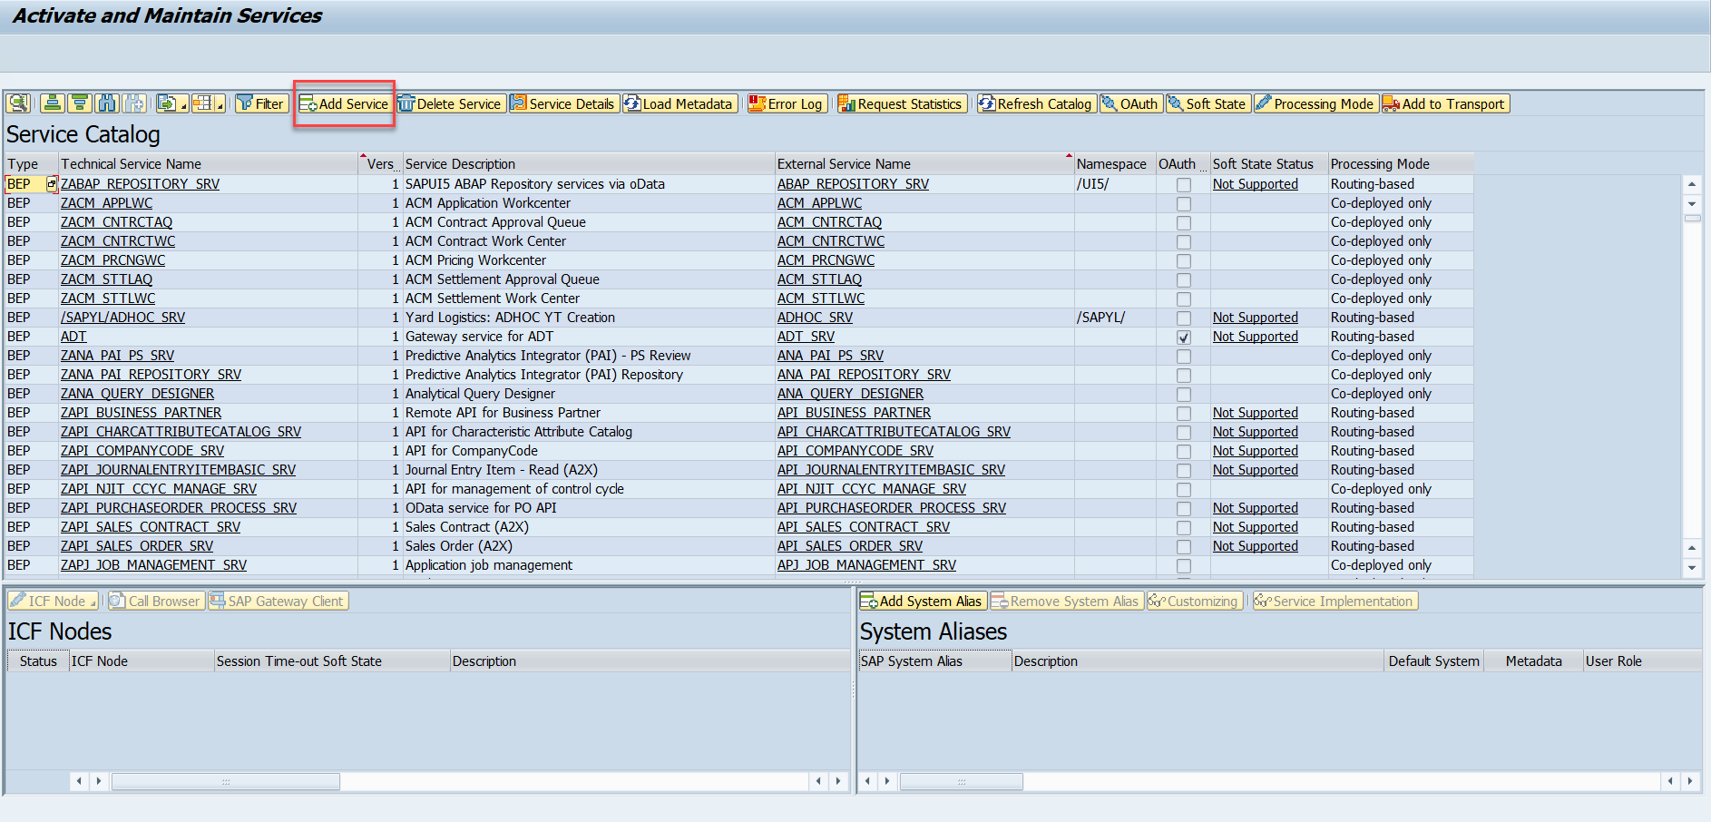
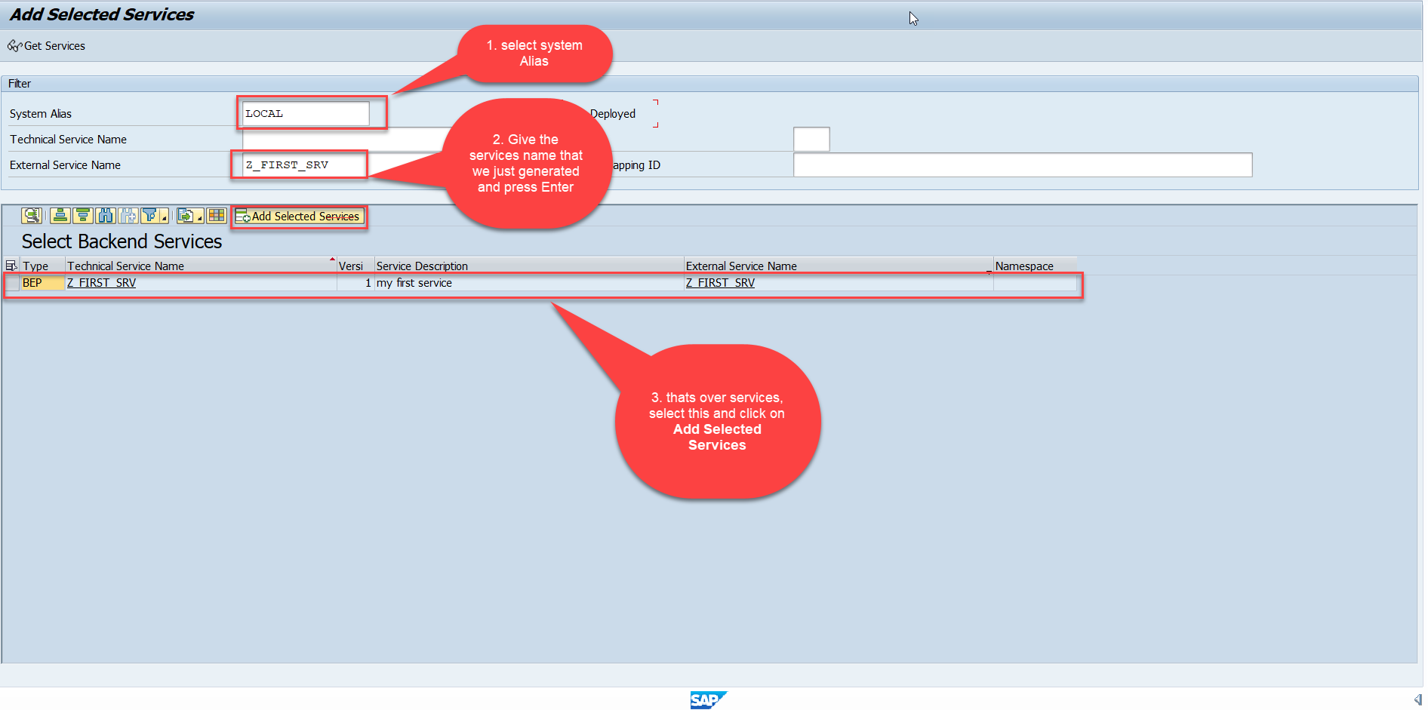
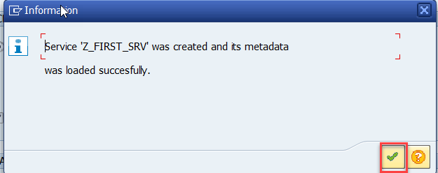
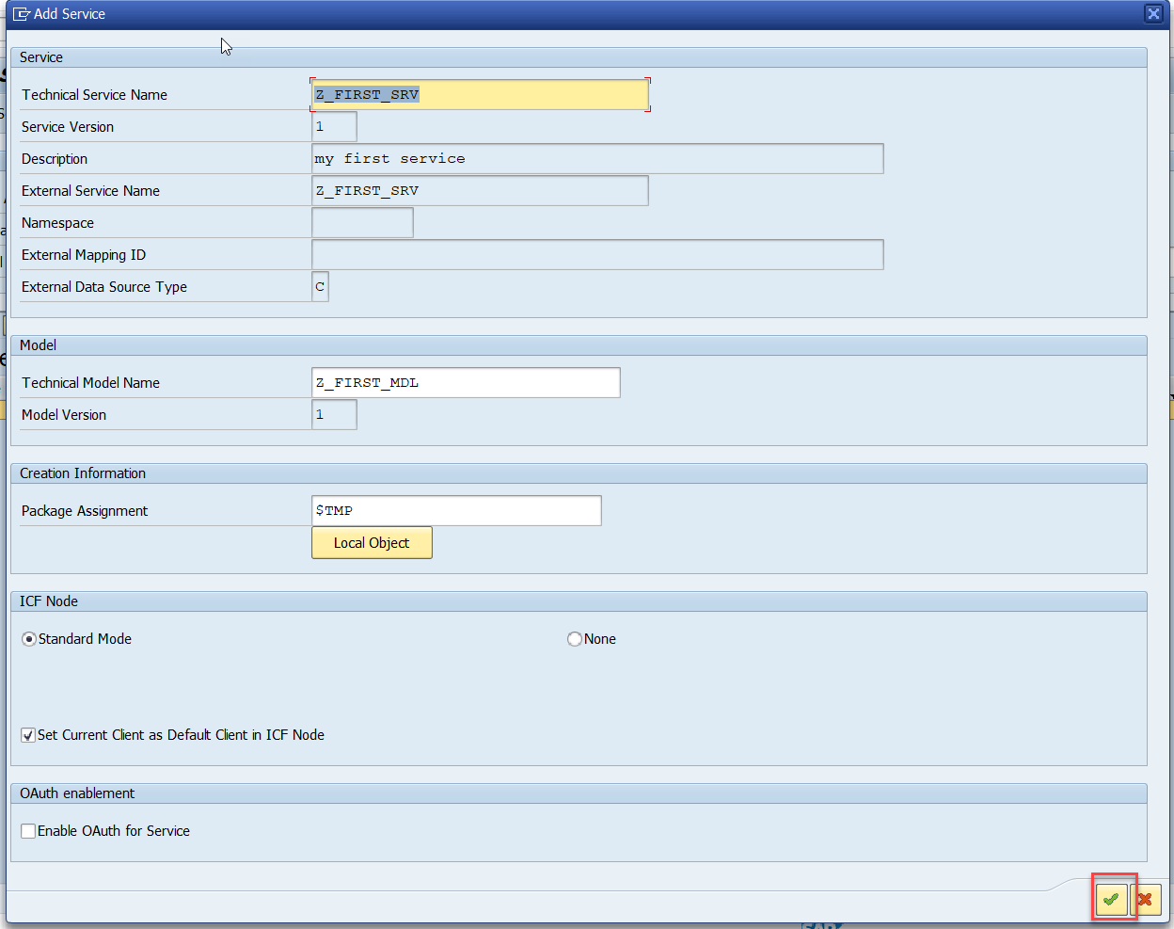
Creating OData Service Continue…
Step5: Service Registration (Go to tcode- /iwfnd/maint_service)

Slide 22

End of Day 8

Slide 23

Questions

Slide 24

Anubhav Oberoy

Slide 25


We’re committed to empower you to be
Most Desirable Resource
through powerful training solutions.
We build the workforce of the future.
250+
Corporate Clients
30,000+
Learners Trained
25000+
Learners Placed
FREE WEBINARS
Sign up for free webinars with industry experts every fortnight!
Enroll Now!
Contact us today!
https://anubhavtrainings.com/

Slide 26




More from AnubhavTrainings.com

Slide 27
Title
Content

